Slide 1
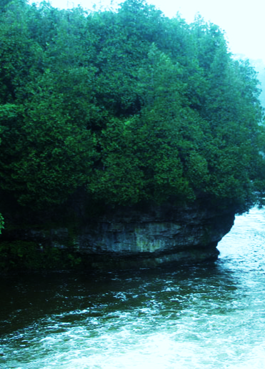
Parks Division Overview
Lucas Rogerson
Manager Of Parks
March 13, 2024

Slide 2
Parks Division Overview
CAO
Managing Director of Community Services
Manager of Parks
Parks Coordinator
Horticulturalist
Urban Forestry Coordinator
Cemetery Administrator
2 x Seasonal Parks/Facilities FTE
2 x Seasonal Parks/ Public Works FTE
8 x Summer Students
3 x Summer Students
1 x Summer Student
Notes:
Who are we?
- Restructuring and new division of Parks in May of 2023
- New hiring of Urban Forestry Coordinator starting Dec 4
- Horticulturalist is ISA Certified Arborist and TRAQ qualified and able to provide support for assessments
This is where are we now with regards to staff & what tools are in currently in place to help manage this program?

Slide 3
Parks
Parks
Grass Maintenance
Sports Field Preparation & Maintenance
Inspections
General Repairs
Garbage collection
Turf Maintenance
Special Event Support
Notes:
First tool is the Public Forest Policy approved in 2018

Slide 4
Parks
Notes:
First tool is the Public Forest Policy approved in 2018

Slide 5
Horticulture
Horticulture
Flowers/ Planters/ Hanging Baskets
Flower bed maintenance
Watering
Town Beautification
Notes:
First tool is the Public Forest Policy approved in 2018

Slide 6
Urban Forestry
Urban Forestry
Public Forest Policy
Public Tree By-law
Trails
Notes:
First tool is the Public Forest Policy approved in 2018

Slide 7
Public Forest Policy 2018
Public Forest Policy
The goal of the Public Forest Policy is:
To enhance the condition of public trees and the quantity of public tree canopy cover in the Township of Centre Wellington.
Notes:
- Policy attached to agenda package
- Policy Established in 2018
The goal of the Public Forest Policy is:
To enhance the condition of public trees and the quantity of public tree canopy cover in the Township of Centre Wellington.

Slide 8
Public Forest Policy
Public Forest Policy
Promote the retention and enhancement of publicly-owned trees
Establish and continue an annual tree-planting program
To assist in guiding and developing tree management practices now and in the future.
Develop a program to identify and manage risks
Build a dynamic inventory of Township Trees
Notes:
Some of the Public Forest Policy objectives are:
To promote the retention and enhancement of publicly-owned trees;
To employ management practices best suited for the establishment and long-term culture of trees across a range of growing conditions, including tree planting in new developments;
To establish and continue an annual tree-planting program with specific planting standards, specifications and recommendations;
To build a dynamic inventory of Township trees;
To develop an accurate and replicable measure of tree canopy;
To develop a program to achieve zero net tree or canopy loss as a result of development;
To develop a program to identify and manage risks associated with trees;
To recognize and promote the important role and contributions that trees and wooded areas perform throughout the Township of Centre Wellington;
To identify and explain the current operations of the Township as they pertain to trees on public property;
To promote diversity of tree species with a preference of native species through the development and use of preferred tree selection lists
To assist in guiding and developing tree management practices now and in the future.

Slide 9
Public Tree By-law 2022-57
A By-law to authorize and regulate the planting, care, maintenance and removal of trees on Township property
Authority
General Provisions
Permits
Compensation
Remedial Action
Notes:
- By-law attached to agenda package
- Is informed by Forestry policy allows for the enforcement of contraventions.
- Intended to be a net zero process, any expenses incurred offset by permit revenues
Authority
- Establishes the authority level of the Township over Public Trees
General Provisions
- Details the permissions to the public. Ie “No person shall” injure, destroy, deface etc.
Permits
Process to be implemented in 2024
Applications for permit
- Outlines the application process and requirements for a permit, as well as compensation values etc.
- Permit issuance conditions and authorization
- terms and conditions
Remedial Action
Outlines remedial actions, enforcement and penalty provisions
A key component to managing and maintaining the forestry program is through an accurate tree inventory system which we have in place through the Township’s GIS system.

Slide 10
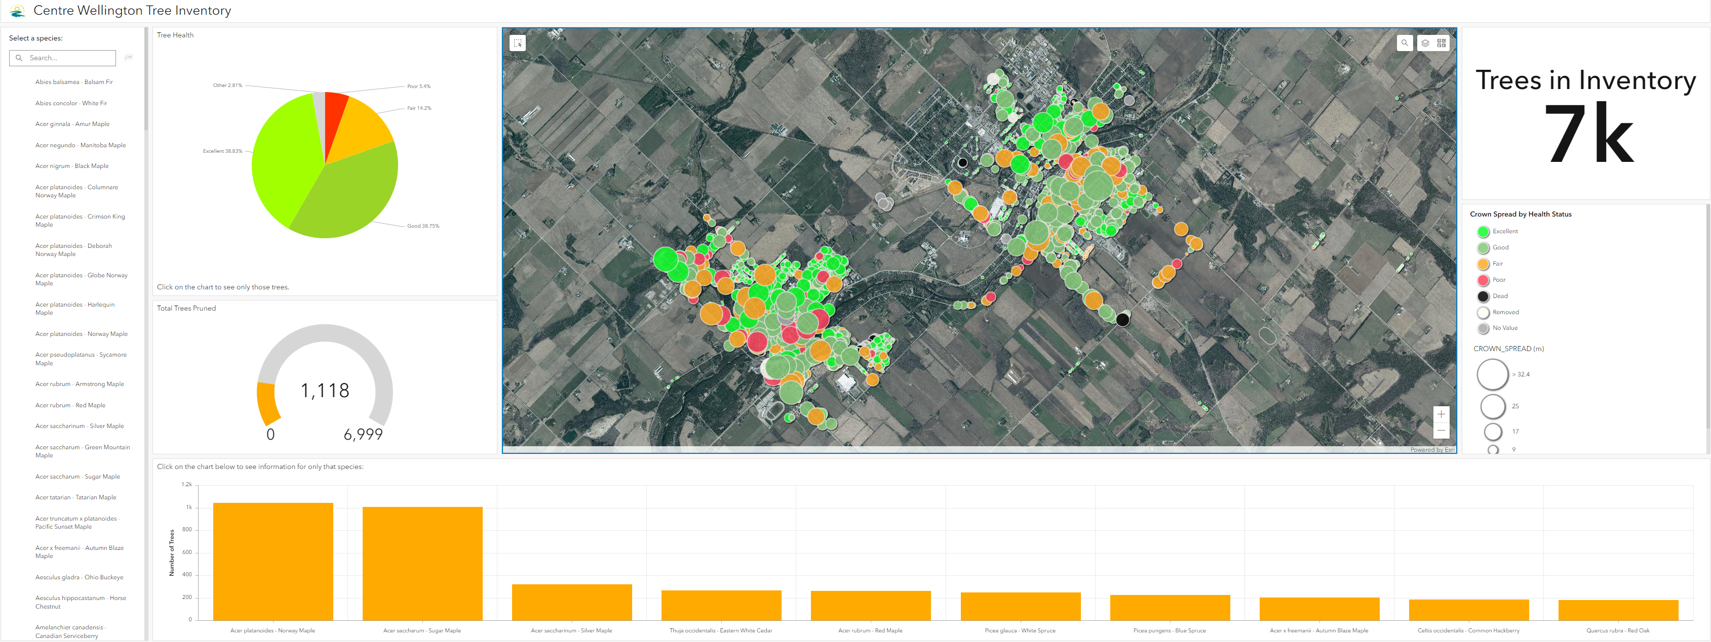
Tree Inventory
centrewellington.ca
Notes:
- Live tree inventory Dashboard located on website centrewellington.ca
- Stores the live data for tree ownership, condition, pruning status etc.
- Living document, will continue to be updated and critical to our forestry program and asset management obligations
- as new subdivisions are brought online, all assets are automatically entered into the inventory

Slide 11
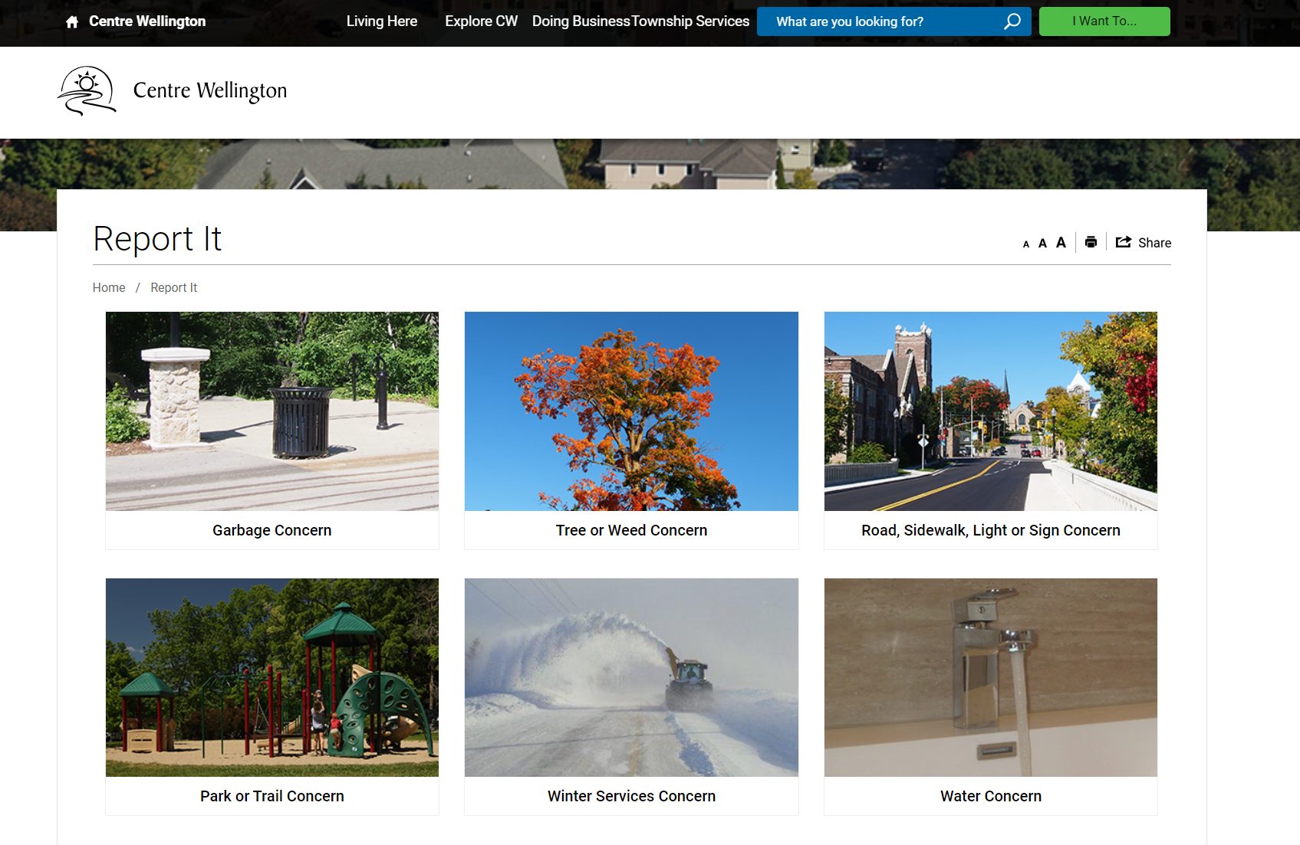
Tree Concerns – Report It
centrewellington.ca
Notes:
Centrewellington.ca
Program is largely complaint based
Automatically creates a Service Request.
Quickest way for staff to respond.
Status tracking to mitigate liability.

Slide 12
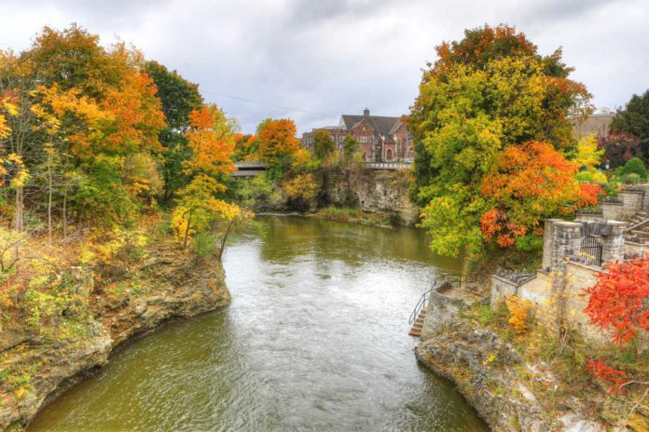
Council’s Vision
The Community to experience life along the Grand River
Notes:
Strategic Plan
Environmental Stewardship
Protect and enhance rural and urban forests
This is what we are working towards for 2024 and beyond to realize Council’s vision of becoming
“The Community to experience life along the Grand River”

